Slide 1


Enterprise Data Platform and role of Apache Spark
Seshu Adunuthula (@SeshuAd)
Notes:
Good Morning Folks, How are you doing? The last talk I had given most of folks were in button down shirts and Suits, nice to be back in the comfort zone.
Great to be at Spark Summit East, Love New York and its Energy very different compared to back in Bay Area.

Slide 2

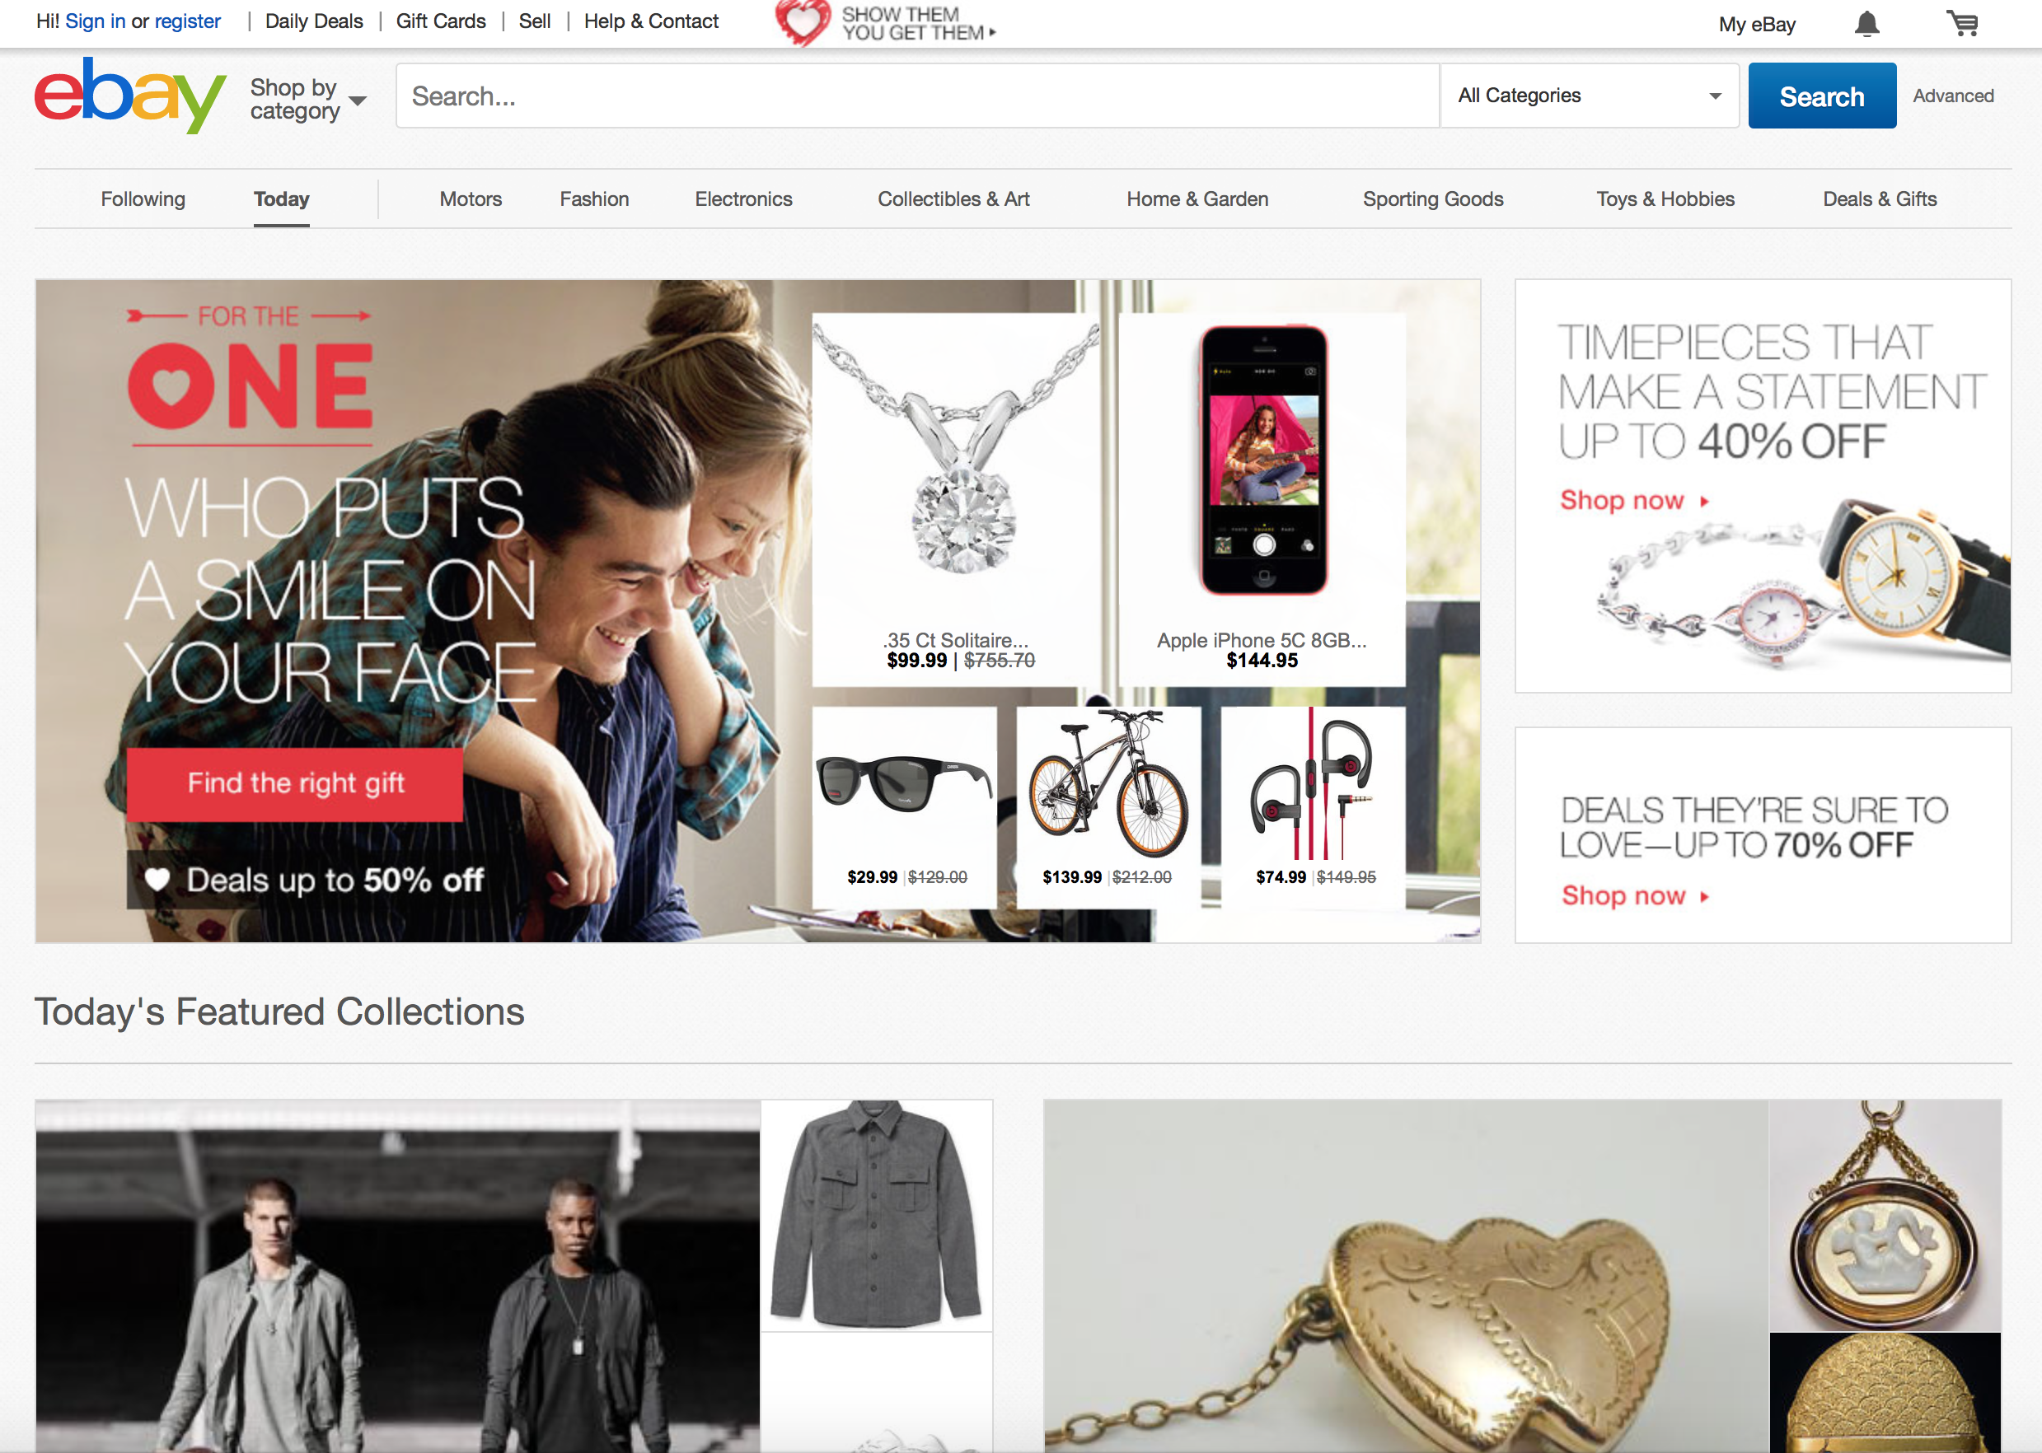
78%
of GMB is fixed price
$29.99
Notes:
So we all know what eBay is. We are the other eCommerce company. As opposed to our brethren up north of us we are not bent on World Domination…

Slide 3
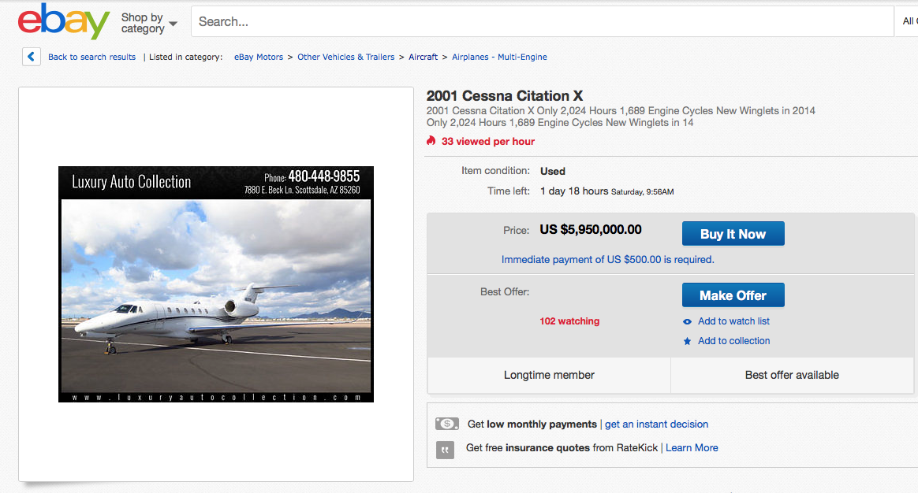
Notes:
You create the coolest Spark Application, you make it big, All you need is 6M Dollars and you can be a proud owner of this Cessna Citation Jet right off eBay.

Slide 4

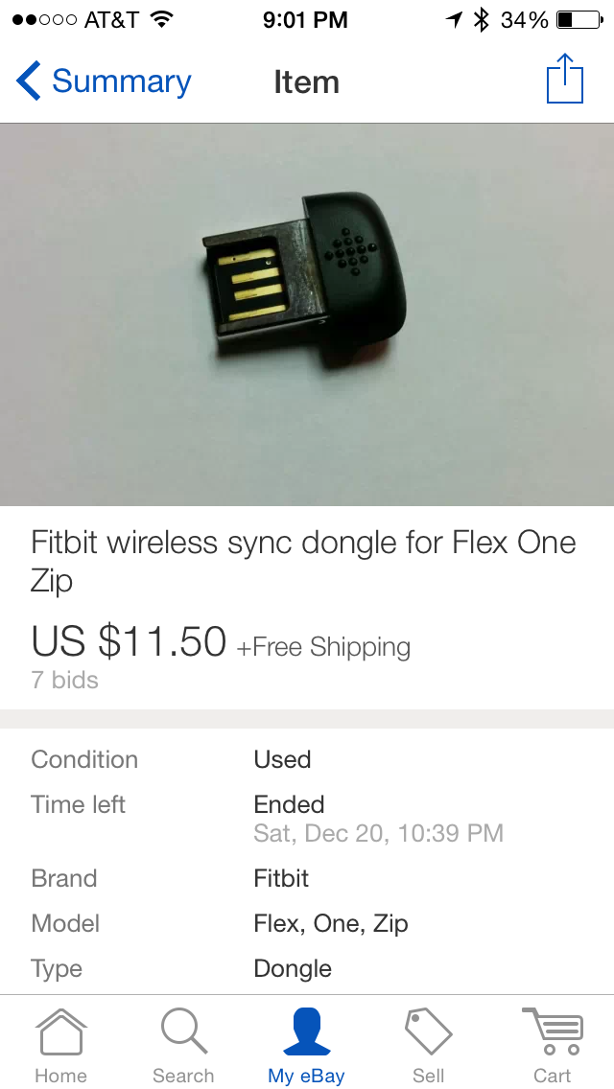
Notes:
To the mundane, You had your fitbit and the little dongle fell off on the flight, eBay to the rescue.

Slide 5
eBay Marketplace
291M
MOBILE APP DOWNLOADS
GLOBALLY
162M ACTIVE BUYERS
800M
ACTIVE LISTINGS
1.3B
LISTINGS CREATED
VIA MOBILE EVERY WEEK
Q4 2015
Q4 2015
25M
ACTIVE SELLERS
8.8M
NEW LISTINGS
EVERY WEEK
42%
GMV VIA MOBILE
Notes:
eBay is a truly Global Market Place.
162M Active Buyers
25M Active Sellers: This is the key differentiation from our competitor up North. A lot of what we do with Analytics is centered around making the Seller successful.
A key to that is the ability to analyze and put structure around the 800M listings we have on eBay with more than 8.8M listings being added every day.
As with every one else more than 40% of the eBay revenue being generated on mobile devices and growing.
References
Active Buyers – Q4 Earnings https://www.ebayinc.com/stories/news/ebay-inc-reports-fourth-quarter-and-full-year-2015-results/
Active Sellers ?
Active listings - Q3 2015 Factsheet
New listings per week - ?
Mobile app (downloads?) globally - Q3 2015 Factsheet
Listings created via mobile - Q3 2015 Factsheet
% GMV Via Mobile - Q3 2015 Factsheet
Q3 2015 Factsheet
https://static.ebayinc.com/static/assets/Uploads/PressRoom/eBay-Factsheet-Q3-2015.pdf?2

Slide 6
Evolving from our Auction Roots..
79%
84%
63%
Items sold are new
Items are fixed price
Transactions offer free shipping
Data is eBay’s Most Important Asset
*Q3 2015 data
Notes:
eBay has gradually evolved from its Auction roots.
79% of Items Sold on eBay are new items
84% of the items are fixed price items
63% of the transaction on eBay offer a free shipping
We evolved into this Global Market Place by treating Data as its one of the most important assets. As a market place we do not hold an inventory, we are in the business of getting the buyers and sellers together and we do this by utilizing the data.

Slide 7
Data is eBay’s DNA
s
BI & Analytical Apps
Behavioral Data
Data Sciences
Structured Data
Convert 800M Item listings into Product pages that are automatically curated and persisted
Traffic – Paid Search
10% efficiency lift for paid search (Amber model)
Identify low performing items (Google search)
Data Preparation.
Bot detection, data transformation, sessionization for user behavior and core data sets
Experimentation
A/B Testing for new features and user Experiences released on the site.
Personalization
User propensity modeling based on 5 quarters behavioral data. Cluster based unstructured data. User (Badges, Activity Synopsis, Word Cloud), Deals Personalization
Merchandising
Similar items - recommending similar items on key placements on site and mobile. Powered among other things by co-clicked items.
Structured Data
Deal discovery leverages machine learning model.
Trust
Predictive machine learning models for fraud prevention, account take-over, prevent loss, bad buying experience prevention, buyer/seller risk prediction
Shipping
Delivery experience: Building a model to predict more accurate and shorter delivery estimates.
SPD: Provides global B2C and C2C seller performance overview
Nous, DNA: Provide self service product experiences analysis on product health, behavior analytics and product domain specific reporting
Search
Search Backend
950M items/ ~15TB indexes in 2.5 hours on a daily basis.
2M item/11TB index subsets generated near real-time in 3 minutes
Search Sciences
Search ranking/spam/recall factors or data (like phrase table, query-rewrite table, etc.) preparation, including many pipelines built on top of search Scala platform
System Services
Sherlock Monitoring: Applications logs (CAL logs) are stored and processed on Hadoop.
Notes:
Data is in eBay’s DNA.
eBay is going through one of its most profound transformations. From Searching Listings to Product Pages that persist beyond the life time of an item that is listed on eBay. We are looking at the 800M listings and automatically converting them into millions of product pages that are generated automatically and persisted beyond the life of a listing. This will tremendously improve the user experience on eBay. We do this not just by looking at the description of an item but looking at how user interact with listing to determine if a new product page is needed or augment the existing product page.
Data Science is extensively deployed in Personalization., Merchandizing, Shipping and Trust. We will go thru a few of these use cases in later slides. At a scale of 800 million listings and 162 million users, computer algorithms instead of human are needed to address most of these needs
Data is at the core of what we do today and it needs an enterprise class platform. We will drill into what it takes to build an Enterprise Class Data Platform. A lot of these idea will resonate with you. Teradata and eBay have had a long partnership and you will see the Oliver’s ideas of Sentient Enterprise in reality today at eBay.

Slide 8
Enterprise Data Platform
Notes:
Additional components are required to extract the value out of data which we are calling the Enterprise Data Platform. In the next few slides I will be talking about the Data Platform we built at eBay. Spark has made gradual inroads into most of the components of our data platform.

Slide 9
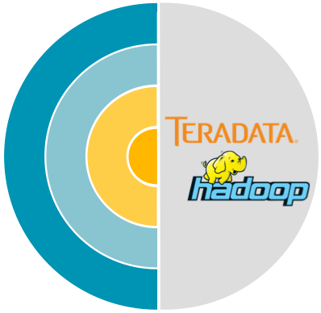


ENTERPRISE DATA PLATFORM
Enterprise Data Platform
Enterprise
Agile Data Warehouse
Data Streams
Data Services
Batch
Humans
Sets of data
Populated
Used by
How
Streams
Systems
Sets of data
Populated
Used by
How
Services
Applications
Specific calls
Notes:
Introduce EDP
We’ve been on the path of the agile data warehouse for a long time
We have the requisite user created data labs, and support experimentation and testing as well as highly integrated core (production) data
Our recent change has been the addition of enterprise data streams
Enterprise data streams are near real time streaming data designed to mirror the critical core data from the EDW but in real time – enhanced with history from the EDW so that actions and recommendations can be made based upon new (live) actions while taking into account rich context
Without this key enabler we could not progress into stage 5: autonomous decision making

Slide 10

Agile Data Warehouse
Analysts/BU PM/Executives/Tools
Analysts/Scientists/Tools
Scientists/Engineers
Relational Analysis
Programmatic Exploration
Structured Data
SQL
Semi Structured Data
Java/Scala…
Interactive Relational Analysis
Batch and Ad-Hoc Algorithmic Analysis
EDW
Hadoop
Notes:
The first component of our Enterprise Data Platform is an Agile Data Warehouse. We decided not to go the route of the Data Lakes instead built Data Sets both in our EDW and Hadoop Systems. Data Sets in EDW support high concurrency interactive analsys while Hadoop designed for semi structured data amenable to programmatic access. Agile

Slide 11
Data Virtualization
Simplify Access to DW
Cross Platform VDMs
Geo Distributed Caches
Notes:
With Data now being stored both in Teradata in Hadoop we came to the realization that a simple unified access is required for our datawarehouse. We should hide the complexity of the different data sources from the Analytics Applications. We are excited about this new initiative within eBay called Davis to integrate the different data sources within our Data Platform
Some of its key capabilities include
Ability to issues SQL queries against both Hadoop and Teradata
Ability to create a cache copy of the data sets from Hadoop/Teradata Essentially VDMs
Geodistribute the cached copies to the edges for global access to the datasets.

Slide 12

Apache Kylin: Extreme OLAP Engine
Apache Kylin: Extreme OLAP Engine
MOLAP Cubes
3rd Party App
(Web App, Mobile…)
SQL-Based Tool
(BI Tools: Tableau…)
REST API
JDBC/ODBC
SQL
SQL
REST Server
ANSI SQL on Hadoop
Query Engine
Mid Latency - Minutes
Routing
Low Latency - Seconds
Hadoop
Hive
Data Cube
Metadata
OLAP
Cube
(HBase)
Interactive Query on Billions
of Rows
Cube Build
Engine
Star Schema Data
Key Value Data
12
Notes:
Another key capability within our Agile Datawarehouse is to get sub second responses on billions of rows of data. With commodity hardware and open source tools we came to the realization that building MOLAP cubes is now a viable and cost effective alternative.
Apache Kylin is an open source MOLAP implementation with the ability to supports cubes that of 10 to 100 TB in size
It has ability to fetch data from variety of sources include Hive and Kafka and build cubes that are stored in Hbase.
These components form the basis for the Agile Datawarehouse at eBay.

Slide 13
Data Streams Platform
Data Streams Platform
Streaming Apps
Real-time Representation
Of EDW Datasets
Risk
Tora
ETL
Rheos App Manager
Hadoop
Teradata
Behavior
TXN
User
Configuration
Centralized Shared Data
Streams
GitHub
Deployment
Connectors
Apache Kafka
Open
Sample Streams
Stream Processing Clusters
DW populated using the
Streams Platform
Needs Approval
Sandbox
Pool1
Pool2
Pool3
Staging
Notes:
Data Streams is a key component of an Enterprise Data Platform.
Traditionally Datawarehouses were populated with end of the day batch processing.
We are replacing this with Streaming based systems
We are introducing the classic Application Development Life Cycles for these streaming applications
Streaming has in general been fragmented with a variety of solutions but recently there has been some standardization being bought into the system
Kafka is quickly being standardized for Messaging. Pub/Sub.
A recent introduction called Apache Beam a high level DSL has the ability to standardize the various stream processing engines in the market.

Slide 14
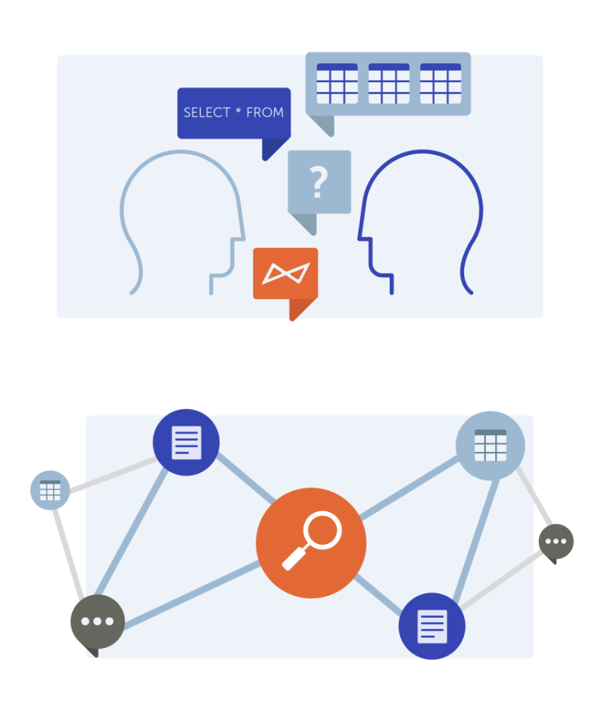
Data Services
Data Services
Data Search & Discovery
Collaborative Analytics
Data Governance
Q3 2015
Notes:
To round up the Enterprise Data Platform: We are providing a variety of services such as
Data Search & Discovery: Ability to search the metadata in the data warehouse. We are looking at integrating the search across both Datawarehouses and Data Streams.
Collaborative Analytics: Sharing queries with others, tagging queries and workspaces etc.
Data Governance: Business Glossaries, Integrated Data Dictionary across Hadoop, Teradata etc.

Slide 15
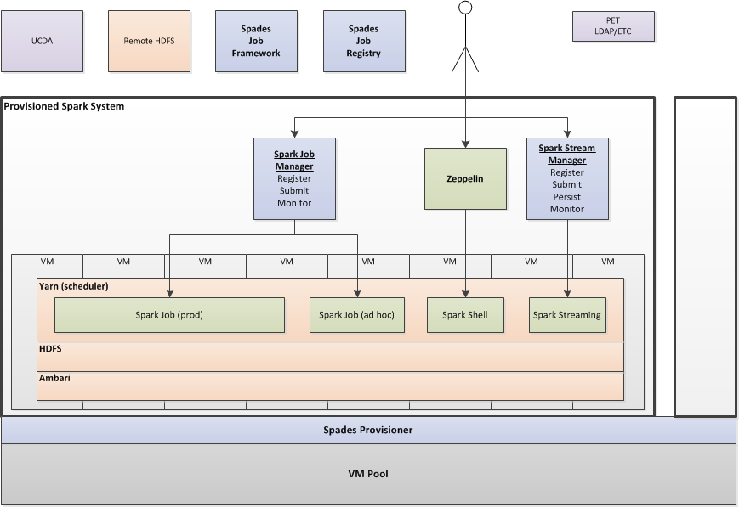
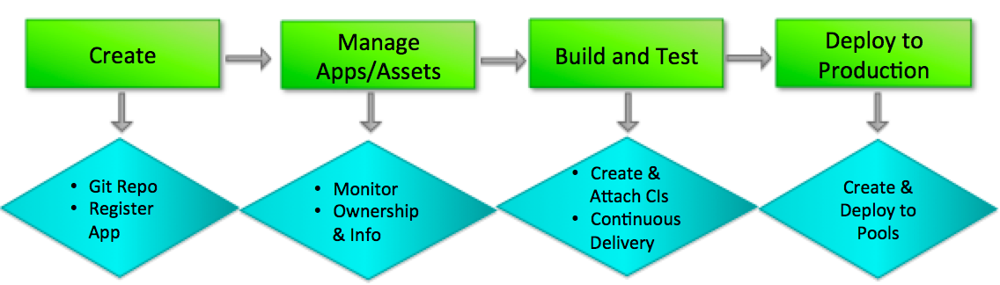
Spades – Spark Provisioning & Deployment Environment
Execution environment tailored for Spark
Governance of Big Data Apps with a PaaS layer
Application life cycle spanning development to deployment
Notes:
As Spark become an important component of our Data Platform we built out a brand new environment highly optimized for Spark with a lot of firsts
We buit this cluster in a virtualized environment as opposed to Bare Metal
We did away with Data Locality and local storage: As a result we were able to use the same compute nodes as other infrastructure within eBay.
We debated a lot on YARN vs Mesos and in the end though Mesos was more performant we went with YARN for two reasons Kerberos integration and Multi-tenant capabilities
Our Hadoop Clustes were like the wild wild west, once you had access you could deploy any application on the clusters. For Spark we introduced a complete App Development Lifecycle

Slide 16
Data Pipelines
Notes:
Time permitting want to talk about our Data Pipelines and impact of Spark. Data Pipelines move Data from our transaction environment into the Analytics world

Slide 17



BEHAVIORAL DATA PIPELINE
Behavioral Data Pipeline
eBay Visitors
Application
Server
CAL
Analytics Platform & Delivery
Analysts
Application
servers
Central App Logging
Listeners
Ingest Servers
Hadoop
Singularity
Notes:
Two types of Pipelines
The behavioral pipeline, all the activity on the web site is captured and stored in the Data warehouses both Hadoop and Teradata. eBay built one of the most sophisticated data pipelines captures around 30TB of activity every day.

Slide 18
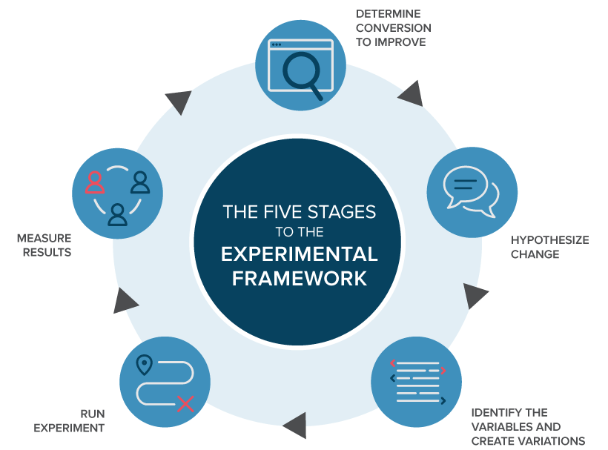
Behavior Data: A/B Testing
Behavioral Data: A/B Testing
Notes:
One of the key applications built on the behavior data pipelines is the Experimentation system. Every new feature released within eBay properties every UI change goes through a series of Experiments before being widely deployed. There are a series of stages within an experimentation system
Determine the features to be added
Identify the variables and create variations in the feature
Run the experiment
Measure the results
Determine which feature needs to be deployed based on data.

Slide 19
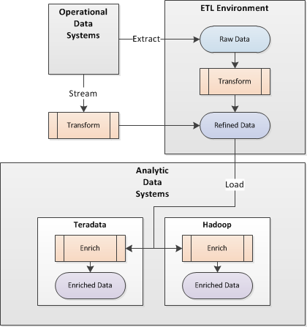
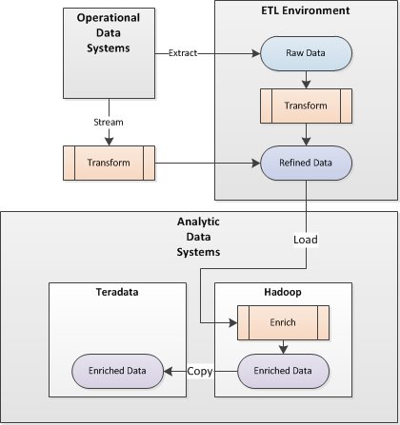
Transactional Data Pipelines
Transactional Data Pipelines
Initial pattern
Subsequent pattern
<95% extract / daily batch
>5% stream / frequent batch
>10% datasets available on Hadoop
New innovation avenues via OpenSource
More data available faster on Hadoop
Leverage Hadoop SQL / Spark
Give humans more Teradata capacity
Teradata data available no later than before
Notes:
Transactional pipelines. These were the oldest pipelines built capture all the transactional activity on the eBay site. Listings Created, Items Sold Auctions state changes etc. A big transformation is changing these pipelines into real time using Spark and Spark streaming.

Slide 20
Notes:
That concludes my talk, In the closing we had built a sophisticated data platform to process large quantities of data and now are gradually witnessing Spark impacting many of the components that form our Data Platform.

